Slide 1
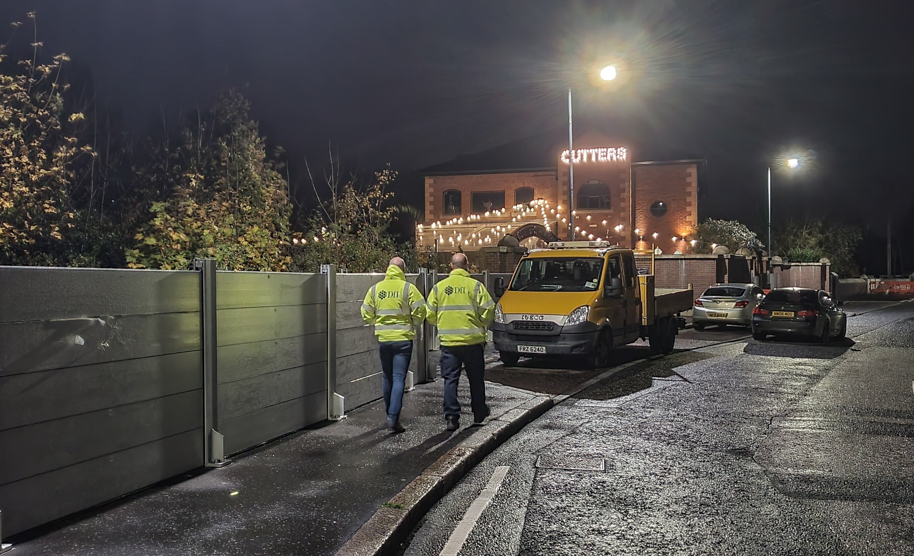
Belfast Tidal Flood Alleviation Scheme
Temporary Deployment Exercise planned for week commencing 14 September 2026 for a duration of approximately 5 days

Slide 2
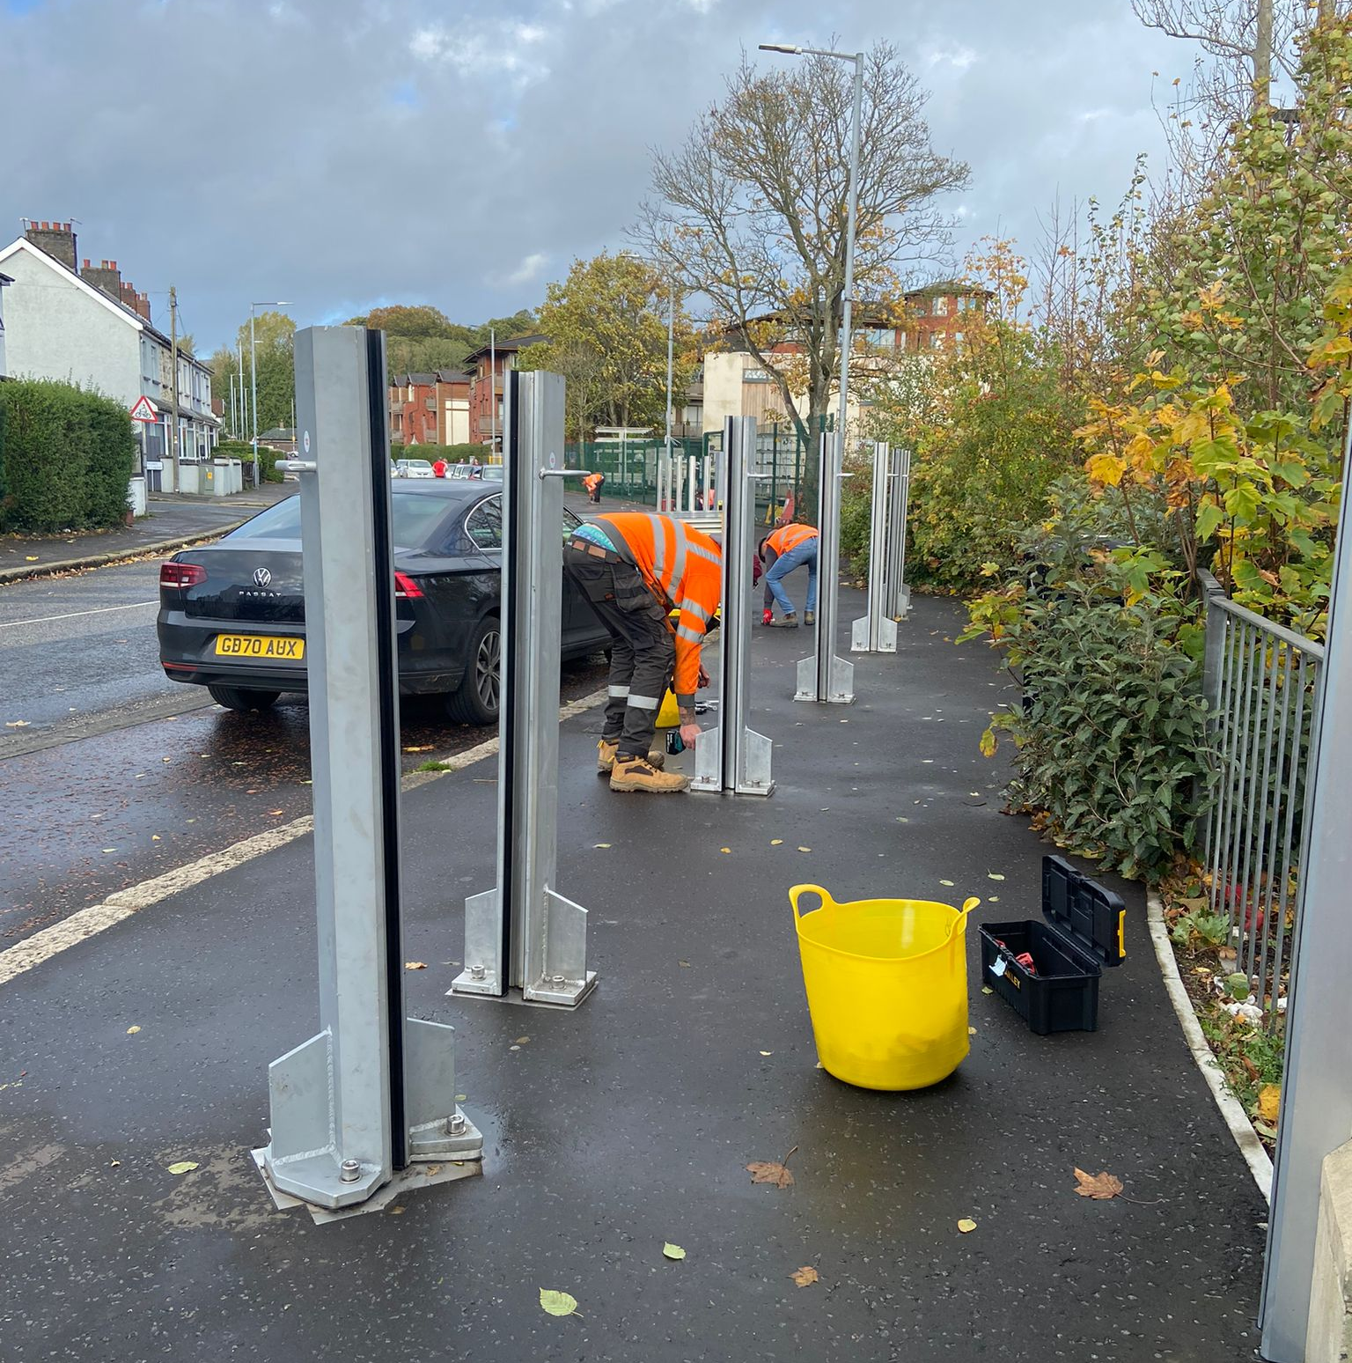
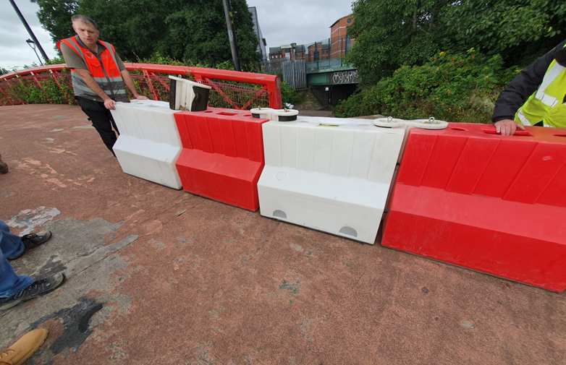
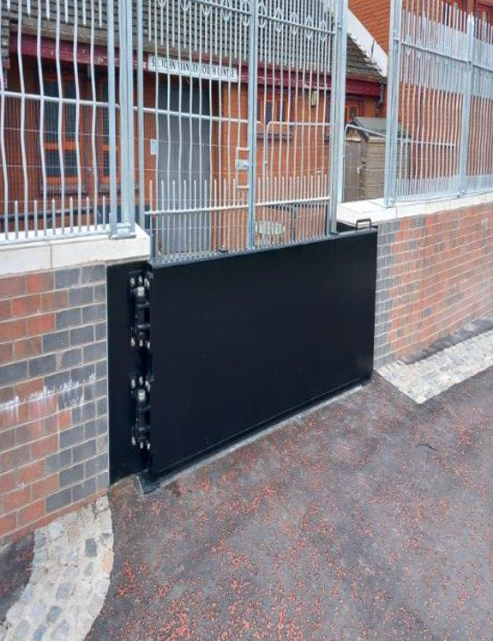
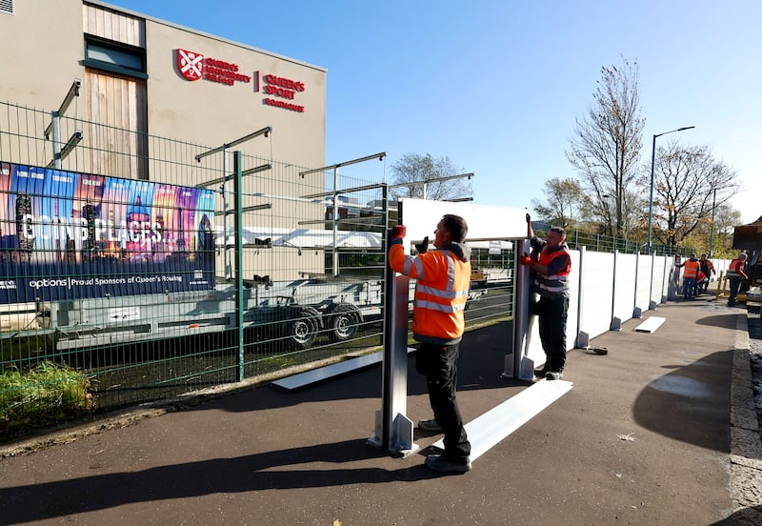
Temporary Deployment Exercise What’s Happening?
A training exercise will take place during the week of 14 September 2026, led by the Department for Infrastructure Rivers Operations team, to deploy temporary flood defences along the Belfast Tidal Flood Alleviation Scheme (BFTAS). The aim is to familiarise staff with the equipment and practice emergency response procedures.

Slide 3
Demountable Flood Defence Deployment
The scheme comprises walls of concrete, brick cladding and glass panels to help it blend into different locations and it stretches along the River Lagan from the harbour estate for some 8km upstream to Stranmillis. As well as the permanent walls along the river it has been necessary to leave some sections and gaps to facilitate daily movement of people and vehicles going about their daily business.
The intention of this exercise is to insert temporary defences into these sections and gaps where the tide is likely to rise to a point that could cause flooding.
Temporary defence types include:
Post and Plank Flood Barriers.
Permanent Flood Gates.
FloodStop Water Filled Flood Barriers.
K-Frame Flood Barriers.

Slide 4
Demountable Flood Defence Deployment
Temporary defence types:
Post and Plank Flood Barriers.
Demountable Flood Gates.
FloodStop Water Filled Flood Barriers.
K-Frame Flood Barriers.

Slide 5
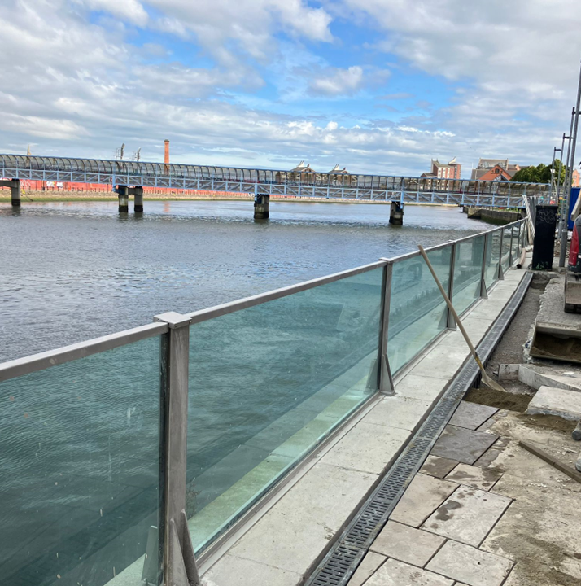
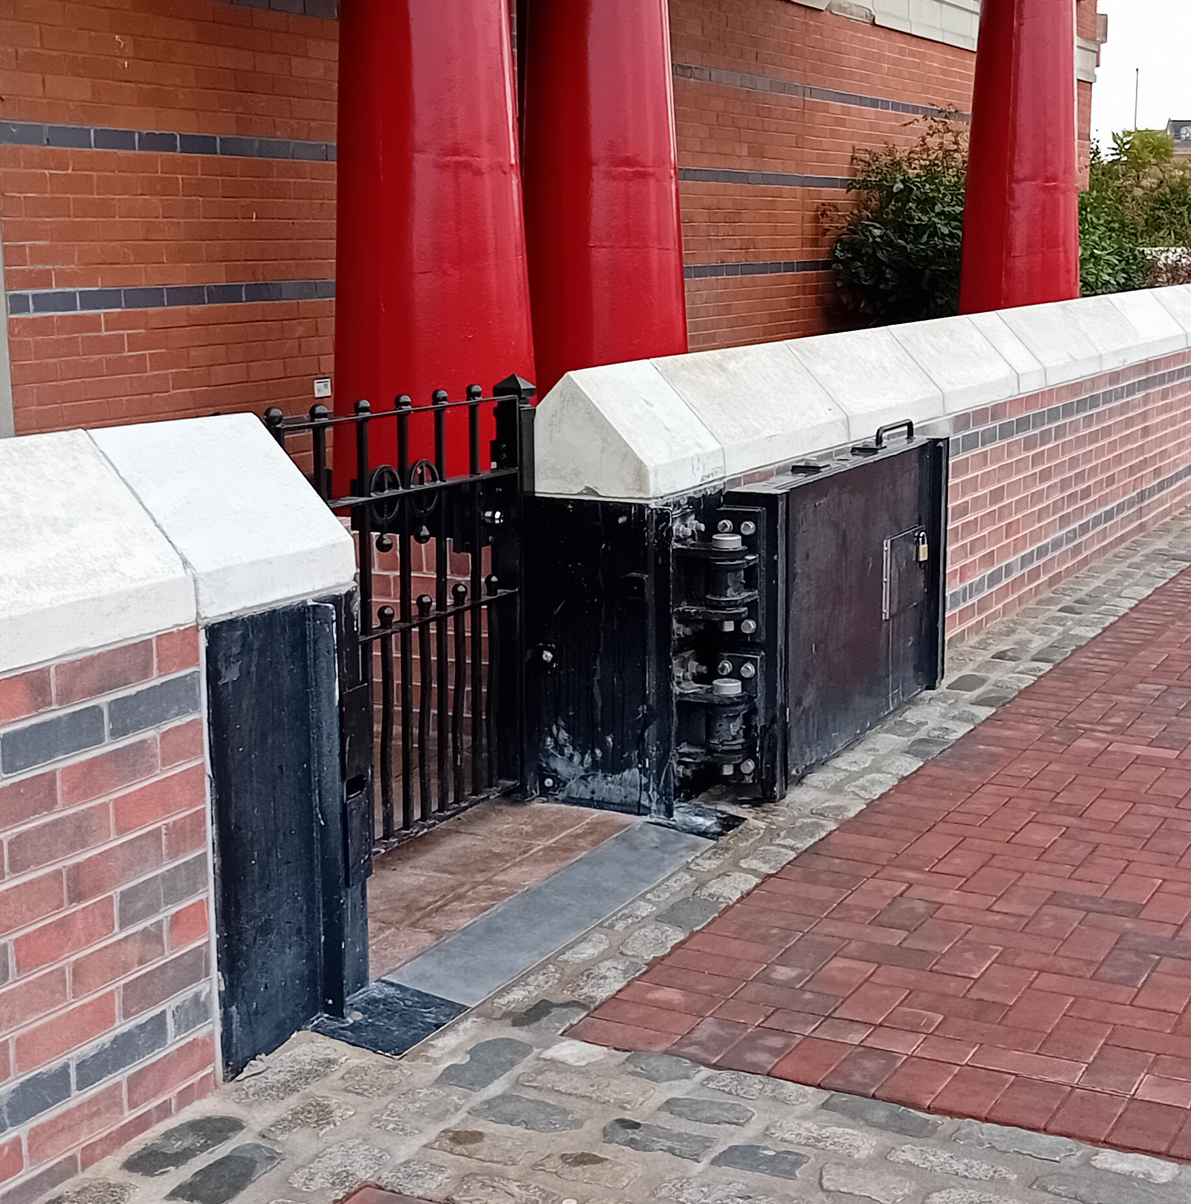
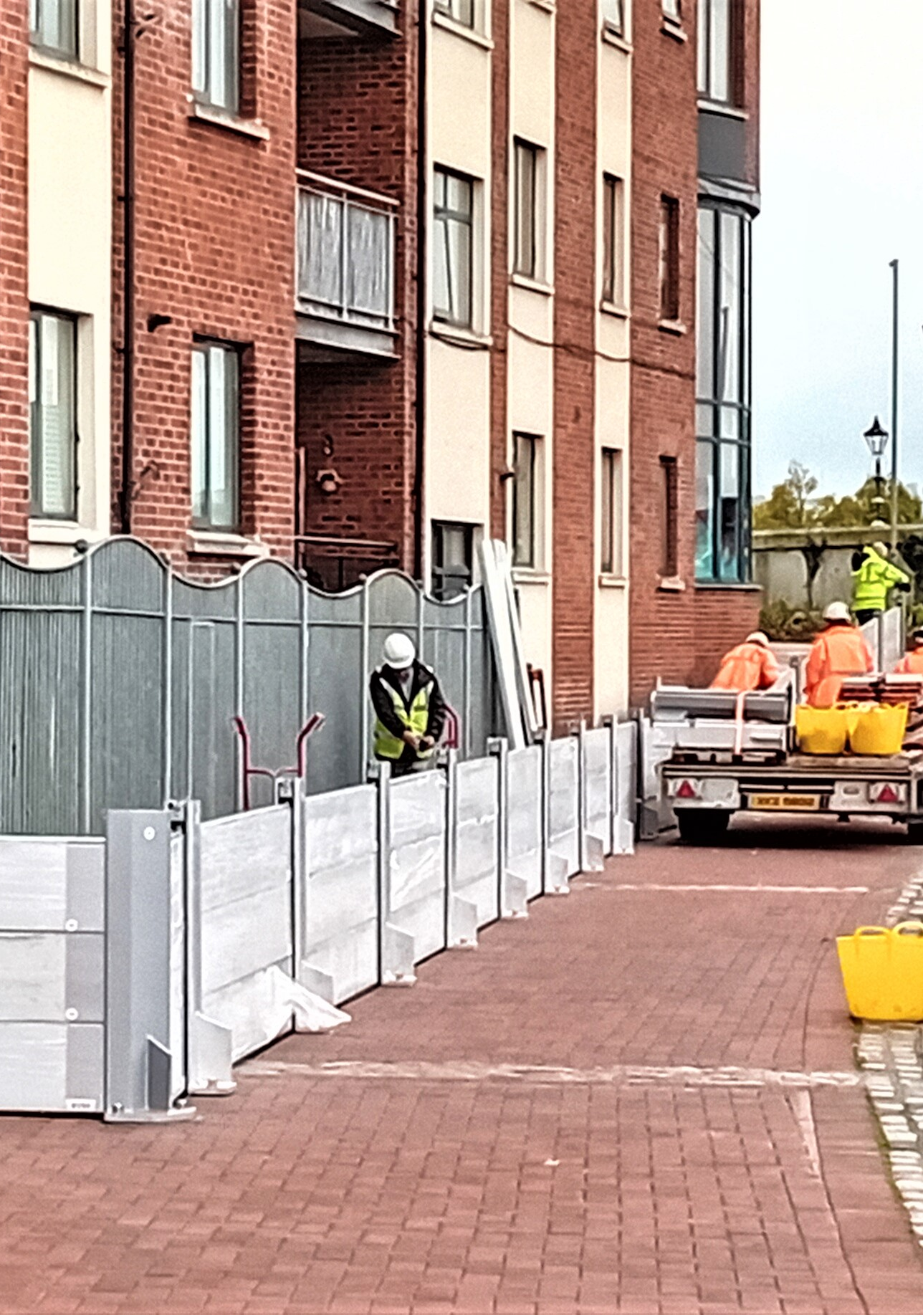
Anticipated Programme
14th September | 15th September | 16th September | 17th September | 18th September
Harbour
 |  | Pottingers Quay Greggs Quay to The O2 Ravenhill Road

Slide 6
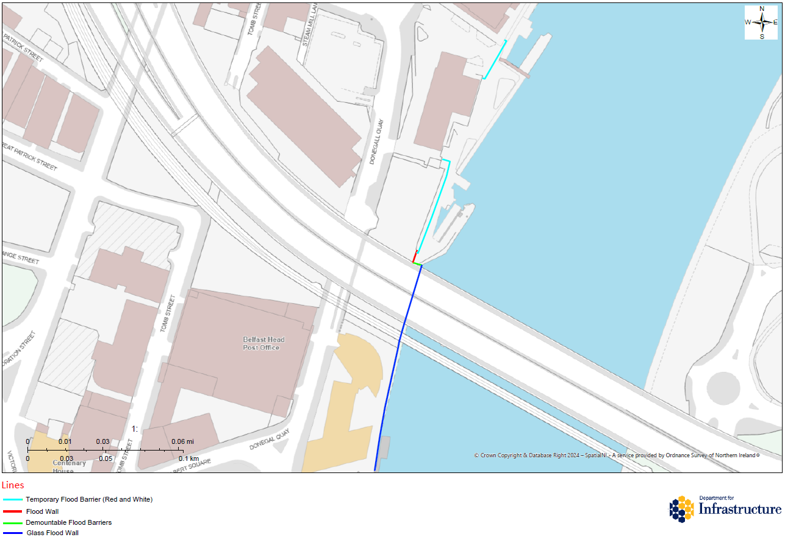
Belfast Harbour
Red / Blue lines are permanent defences.
Green / Blue lines are temporary deployment locations.
Works to install temporary sections on 14th to 16th September 2026.
Footpath / Towpath restrictions likely from 14th September 2026 for approximately 3 days.

Slide 7
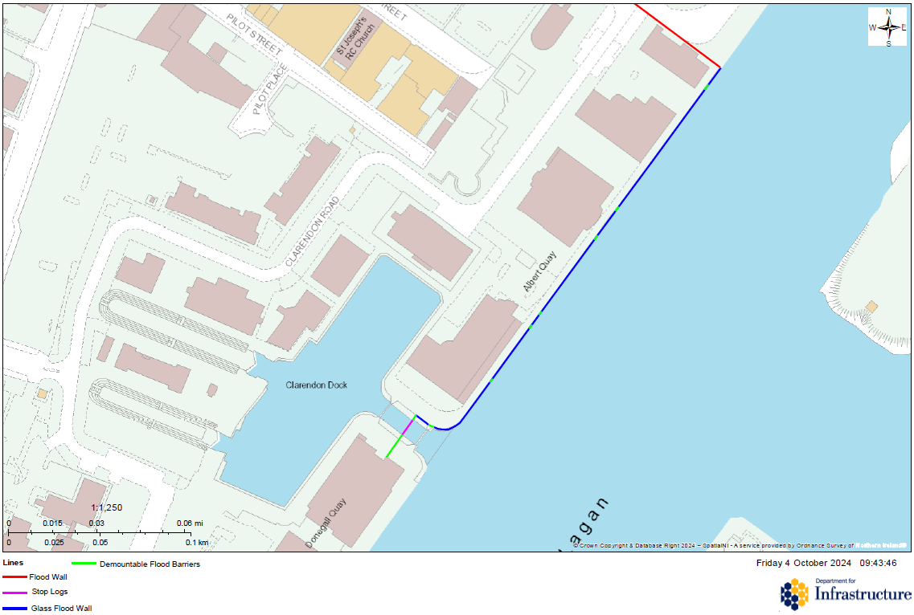
Belfast Harbour
Red / Blue lines are permanent defences.
Green / Magenta lines are temporary deployment locations.
Works to install temporary sections on 14th to 16th September 2026.
Footpath / Towpath restrictions likely from 14th September 2026 for approximately 3 days.

Slide 8
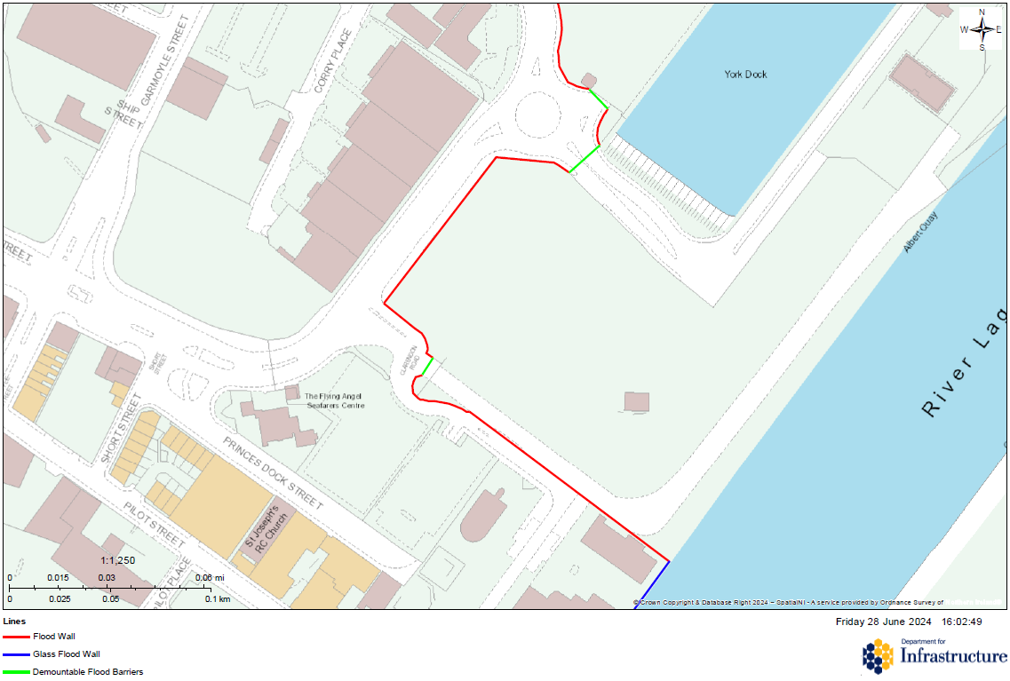
Belfast Harbour
Blue / Red lines are permanent defences.
Green lines are temporary deployment locations.
Works to install temporary sections from 14th to 16th September 2026.
Footpath / Towpath restrictions likely from 14th September 2026 for approximately 3 days.

Slide 9
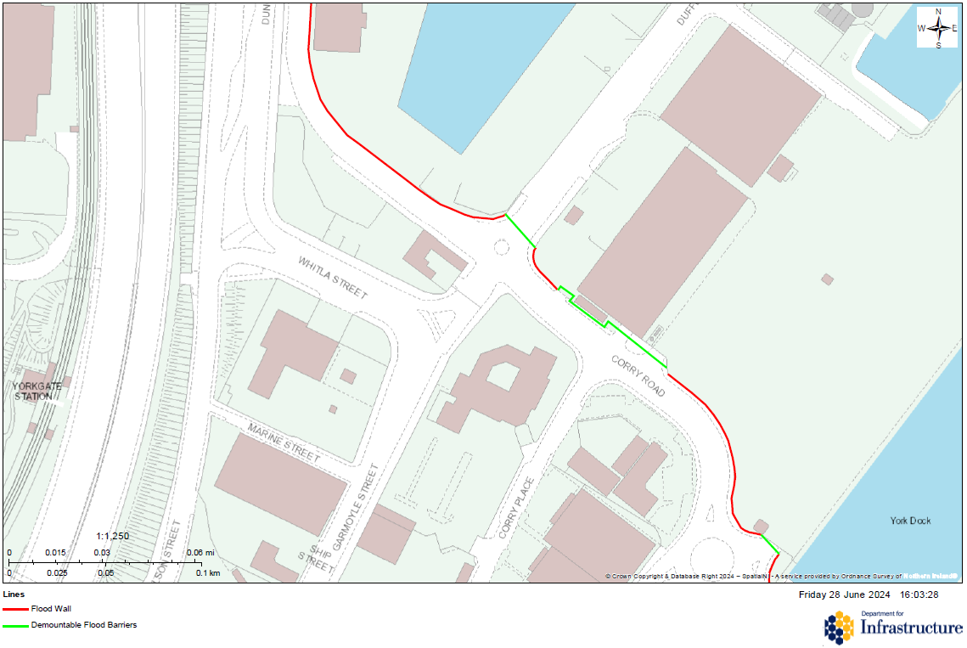
Belfast Harbour
Red lines are permanent defences.
Green lines are temporary deployment locations.
Works to install temporary sections from 14th to 16th September 2026.
Footpath / Towpath restrictions likely from 14th September 2026 for approximately 3 days.

Slide 10
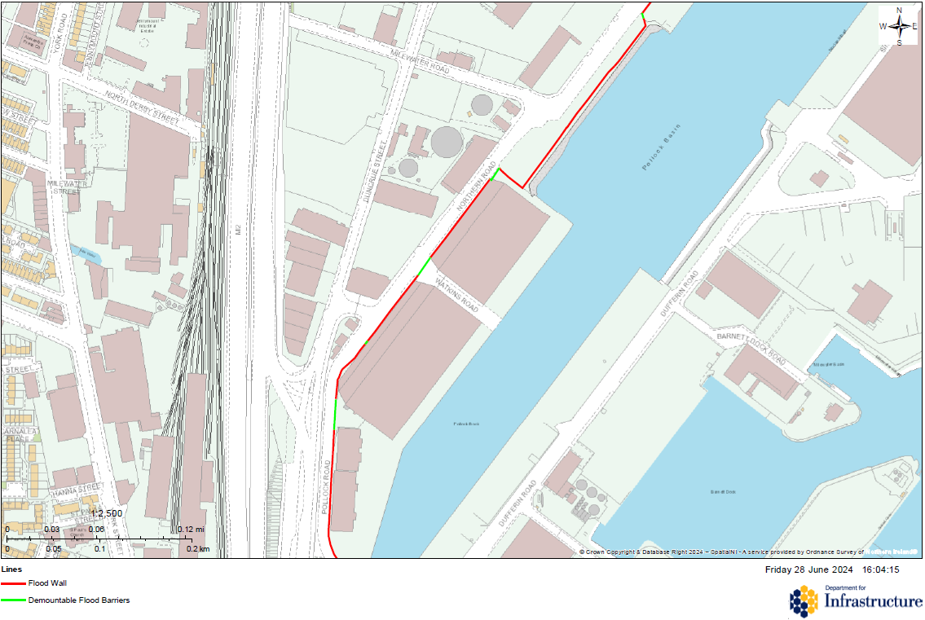
Belfast Harbour
Red lines are permanent defences.
Green lines are temporary deployment locations.
Works to install temporary sections from 14th to 16th September 2026.
Footpath / Towpath restrictions likely from 14th September 2026 for approximately 3 days.

Slide 11
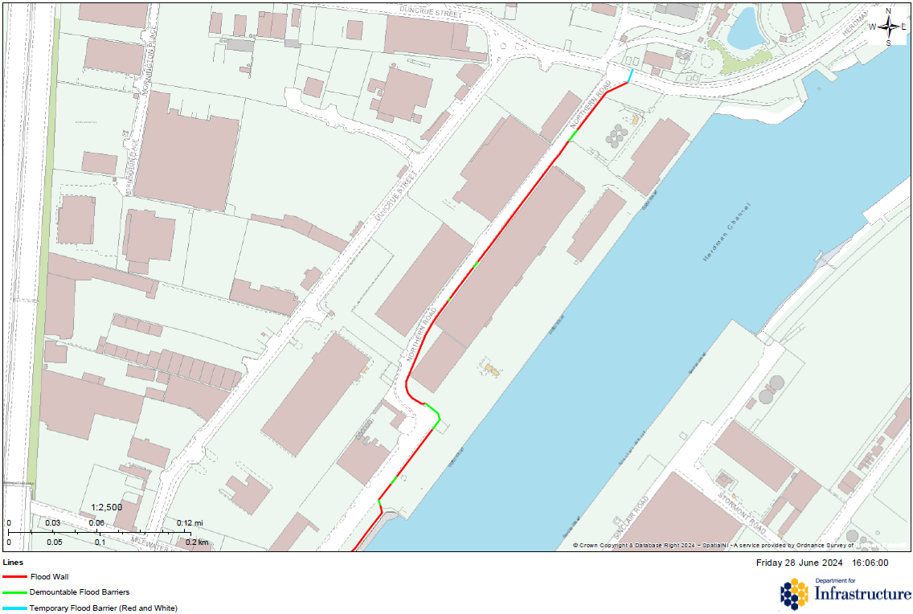
Belfast Harbour
Red lines are permanent defences.
Green / Blue lines are temporary deployment locations.
Works to install temporary sections from 14th to 16th September 2026.
Footpath / Towpath restrictions likely from 14th September 2026 for approximately 3 days.

Slide 12
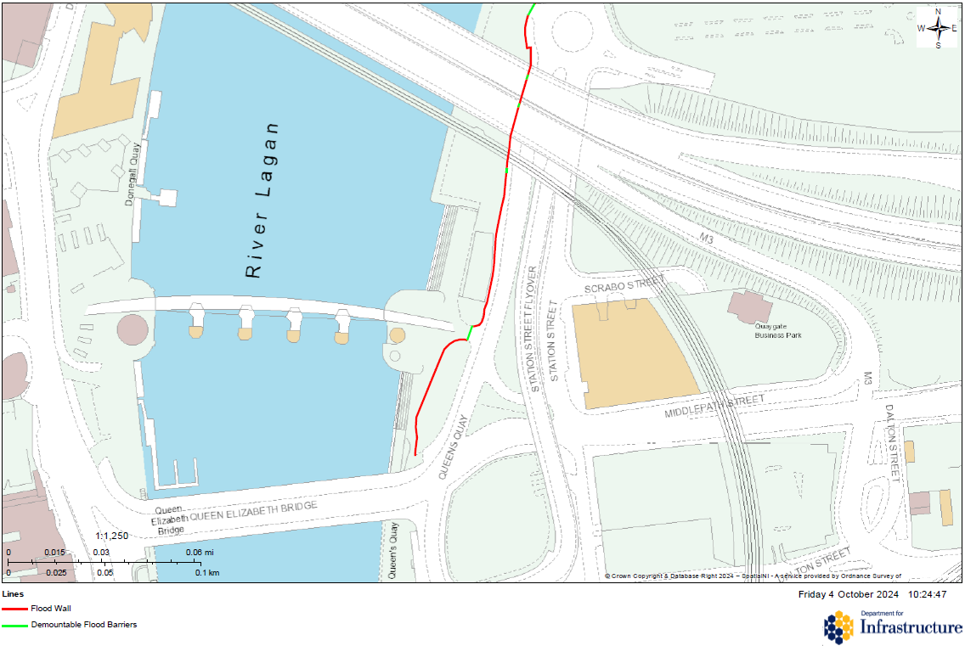
Sydenham (Greggs Quay to O2)
Red lines are permanent defences.
Green lines are temporary deployment locations.
Works to install temporary sections from 17th to 18th September 2026.
Footpath / Towpath restrictions likely from 17th September 2026 for approximately 2 days.

Slide 13
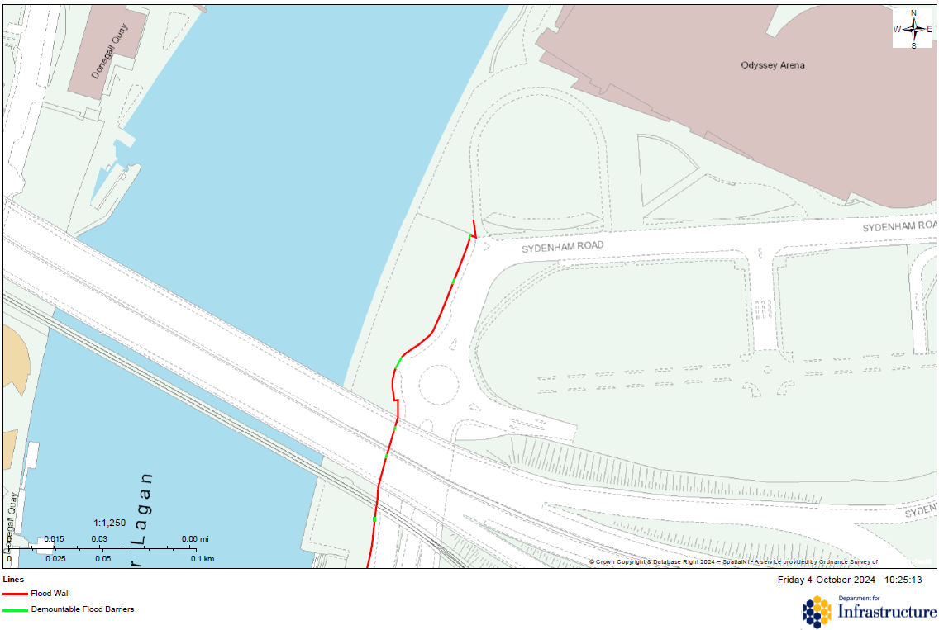
Sydenham (Greggs Quay to O2)
Red lines are permanent defences.
Green lines are temporary deployment locations.
Works to install temporary sections from 17th to 18th September 2026.
Footpath / Towpath restrictions likely from 17th September 2026 for approximately 2 days.

Slide 14
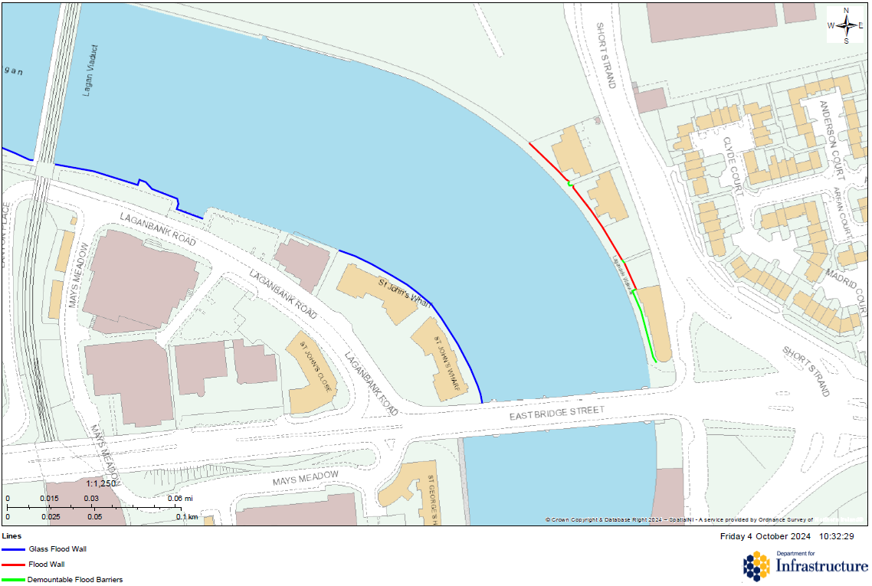
Sydenham (Pottingers Quay)
Red / Blue lines are permanent defences.
Green lines are temporary deployment locations.
Works to install temporary sections on 17th September 2026.
Footpath / Towpath restrictions likely on 17th September 2026 for approximately 1 days.

Slide 15
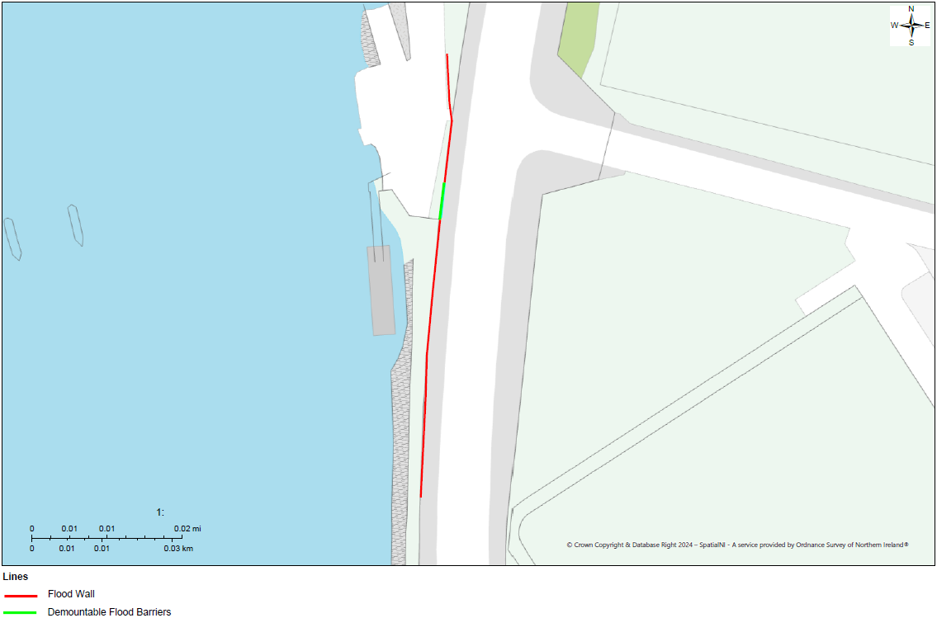
Ravenhill
Red lines are permanent defences.
Green lines are temporary deployment locations.
Works to install temporary sections from 17th to 18th September 2026.
Footpath / Towpath restrictions likely from 17th September 2026 for approximately 2 days.

Slide 16
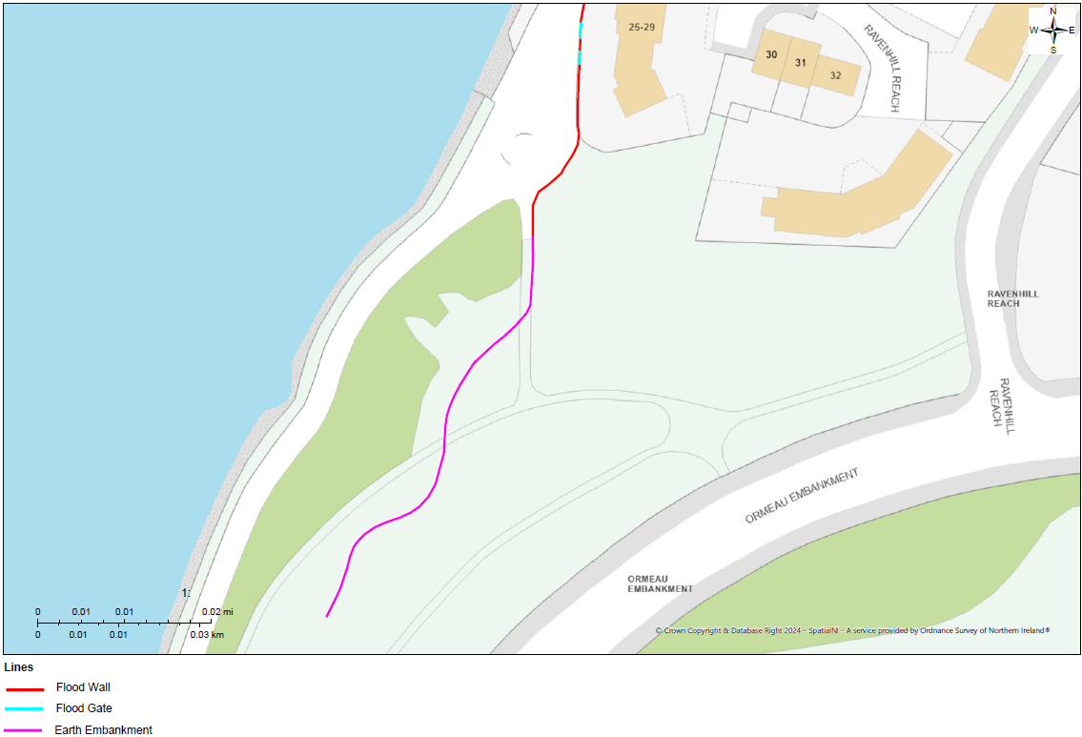
Ravenhill
Red / Magenta lines are permanent defences.
Blue lines are temporary deployment locations.
Works to install temporary sections from 17th to 18th September 2026.
Footpath / Towpath restrictions likely from 17th September 2026 for approximately 2 days.

Slide 17
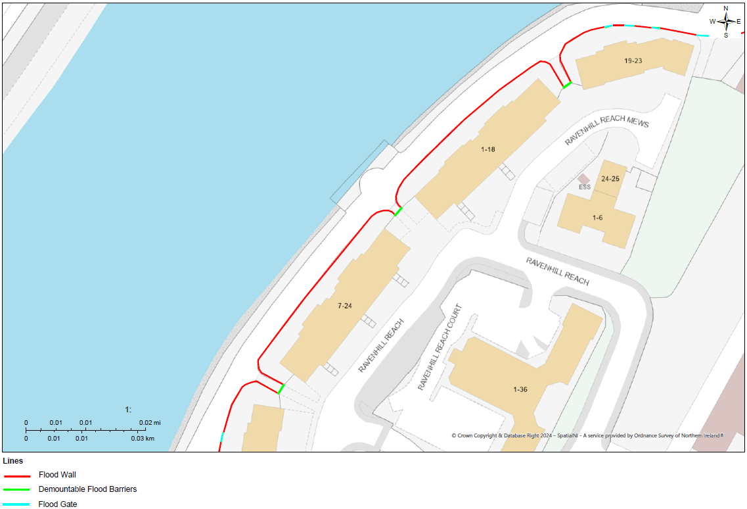
Ravenhill
Red lines are permanent defences.
Green / Blue lines are temporary deployment locations.
Works to install temporary sections from 17th to 18th September 2026.
Footpath / Towpath restrictions likely from 17th September 2026 for approximately 2 days.

Slide 18
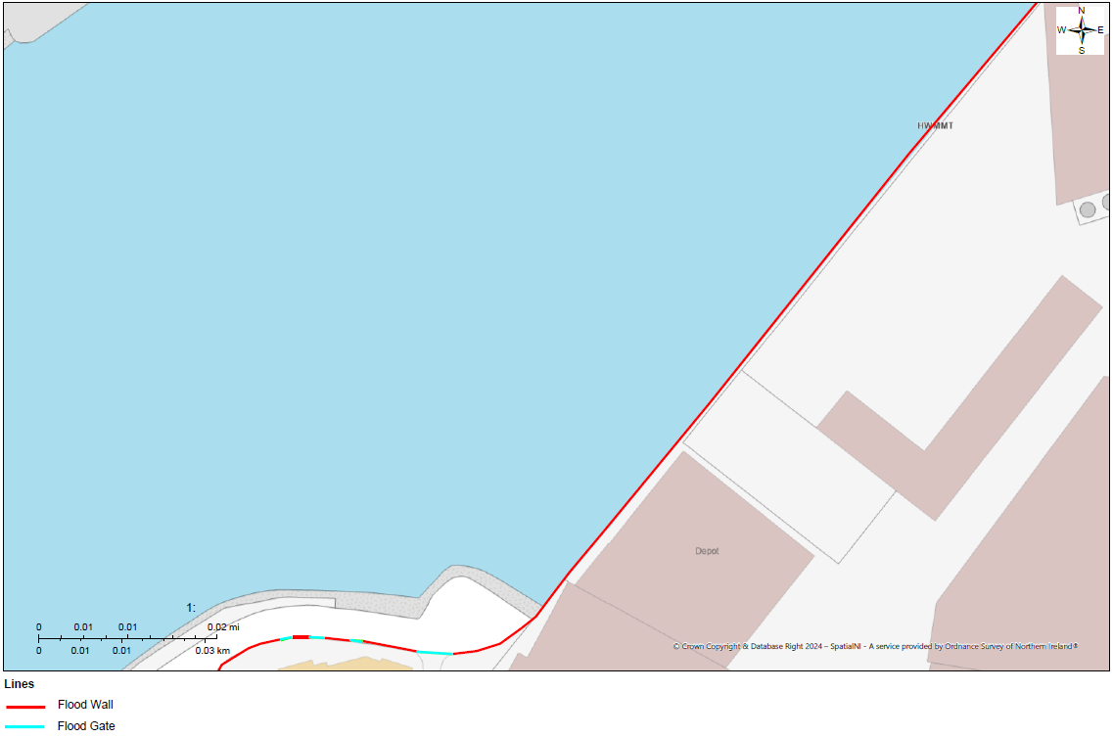
Ravenhill
Red lines are permanent defences.
Blue lines are temporary deployment locations.
Works to install temporary sections from 17th to 18th September 2026.
Footpath / Towpath restrictions likely from 17th September 2026 for approximately 2 days.

Slide 19
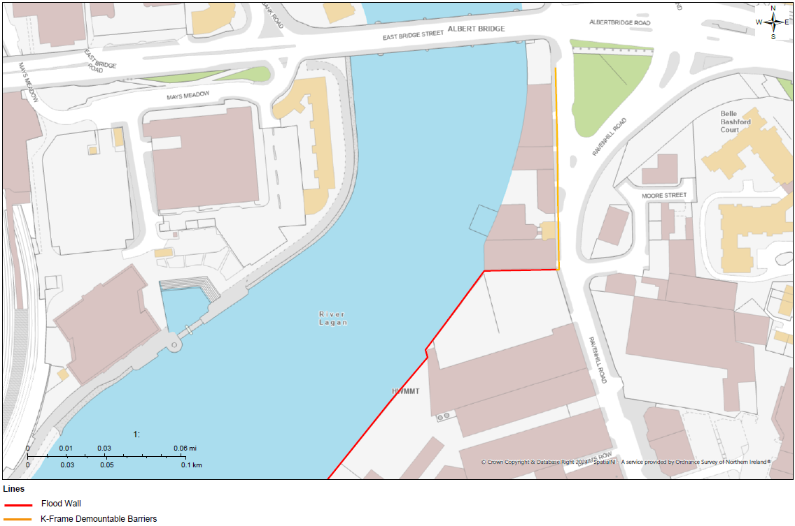
Ravenhill
Red lines are permanent defences.
Brown lines are temporary deployment locations.
Works to install temporary sections from the 16th to 17th September 2026.
Footpath / Towpath restrictions likely on the 16th September 2026 for approximately 2 Days.

Slide 20
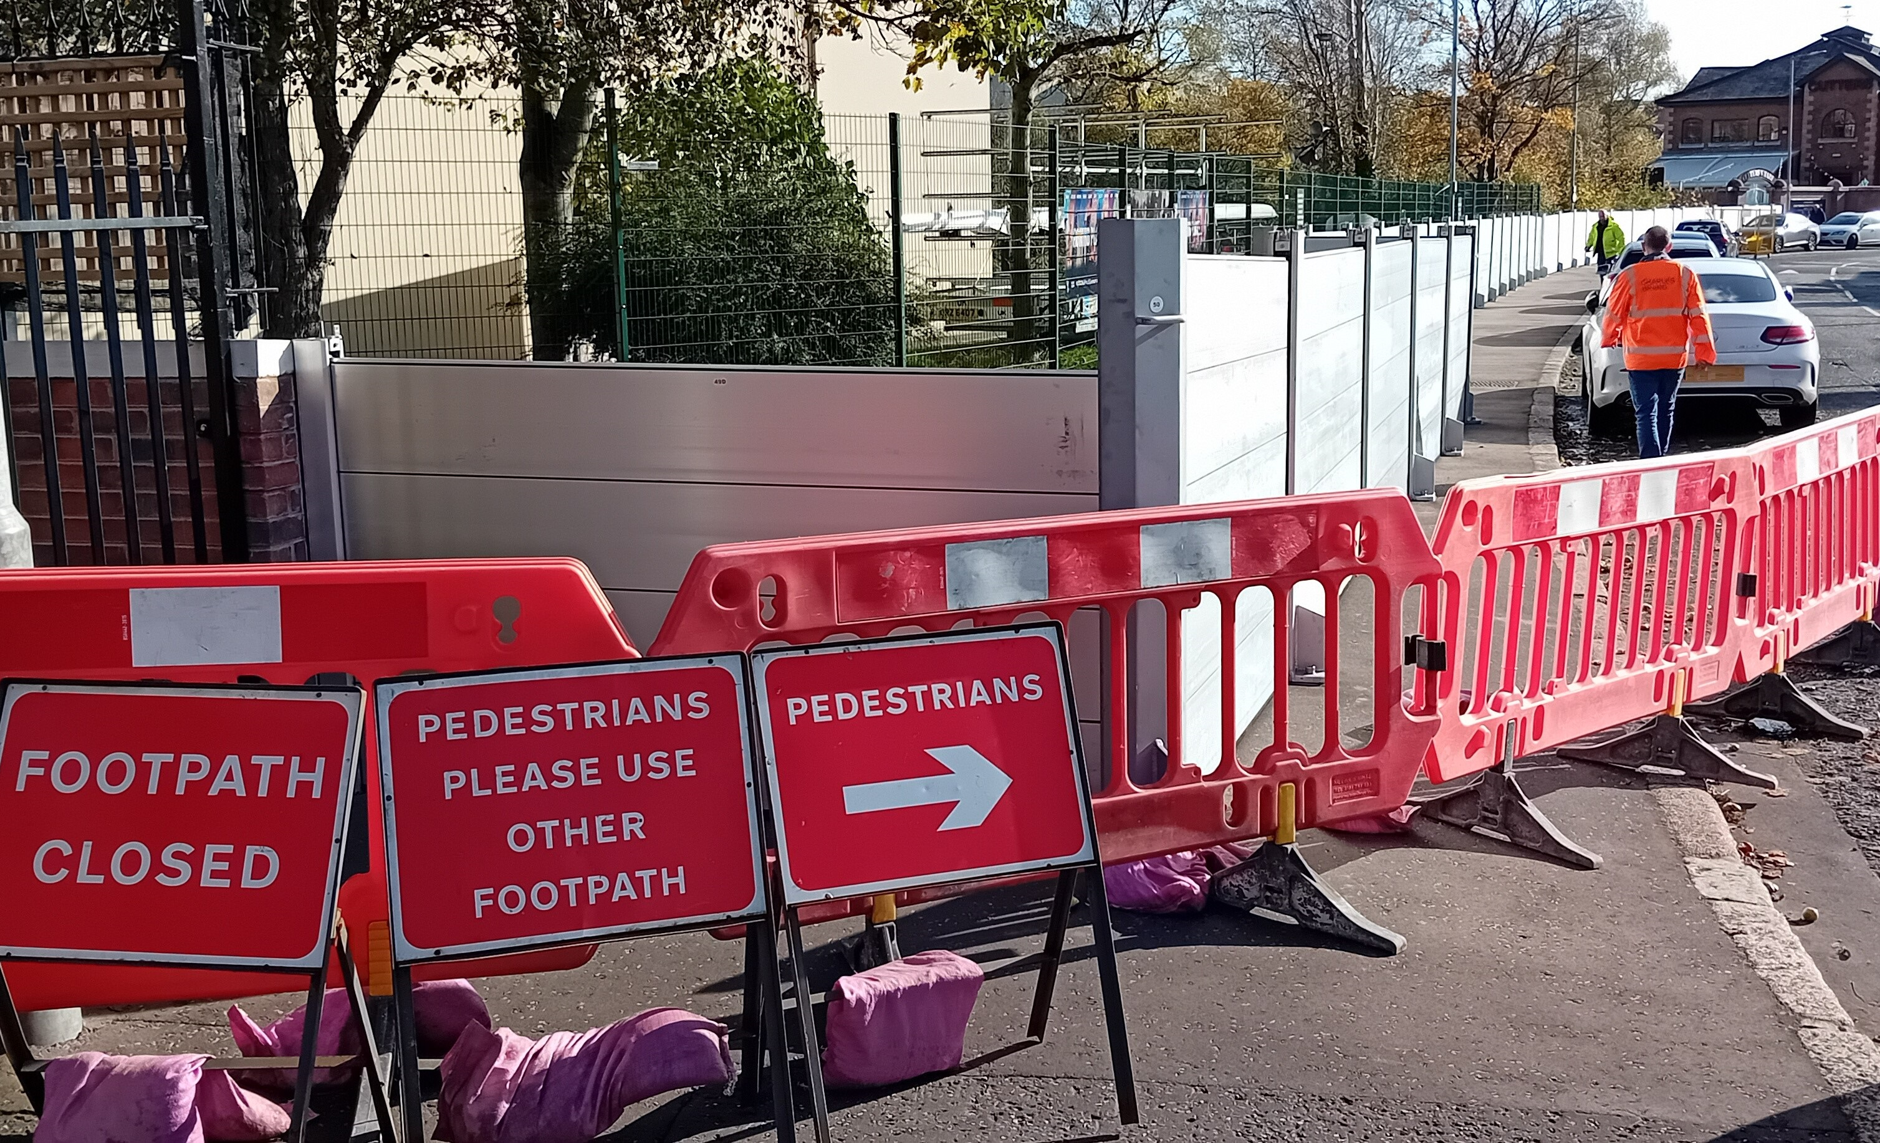
Queries?
Contact – rivers.belfast@infrastructure-ni.gov.uk

